Slide 1


Digital Freelancer:
Managing Freelancing Projects
Project: Working with a Mock Client

Slide 2
Part 1
Project Listing

Slide 3
Sample Project Listing #1: Web Development
Web application development support needed for healthcare application.
Posted 2 hours ago
Hourly: $35.00 - $65.00 Based on experience.
Project Time: 3 months, 25 hours a week.
Project Description:
We are a web development company working with a healthcare client looking to connect patients directly with their doctors. We need someone to be able to take PSD mockup files from our designer and convert them into custom code using HTML, CSS, and JavaScript. We have not decided on which JavaScript library to use, but will be open to working with the one you’re most familiar with. We have the designs for 10 pages and will need them to be completed in 3 months. We are open to working with all levels of experience, but the pay will be adjusted based on your experience.

Slide 4
Part 2
Expression of Interest

Slide 5
Expression of Interest (Provided)
Which Sample Project Listing did you select to respond to?
Answer: Web application development support needed for healthcare application.
Please type your initial response to the client below:
Expression of Interest:
My name is Ahmed Saed, a web developer. I was so excited to hear about your offer. I have created multiple of websites for the last year. I wanted to reach out and express my interest in applying for the offer.
I have worked as a freelancer in the web development field for the last year. During that time, I've developed strong customer service skills and learned a lot about web technologies, development of websites and I have worked with multiple frameworks.
It looks like you need to connect patients directly with their doctors by taking PSD mockup files from designers and convert them into custom code using HTML, CSS, and JavaScript. I’d recommend using React JS It is an open-source JavaScript library used to build highly responsive user interfaces. It is declarative and component-based meaning you can reuse components to create complex UIs in a short time. I have great experience working on such projects. Please let me know if you would like to connect

Slide 6
Part 3
Project Management Process

Slide 7
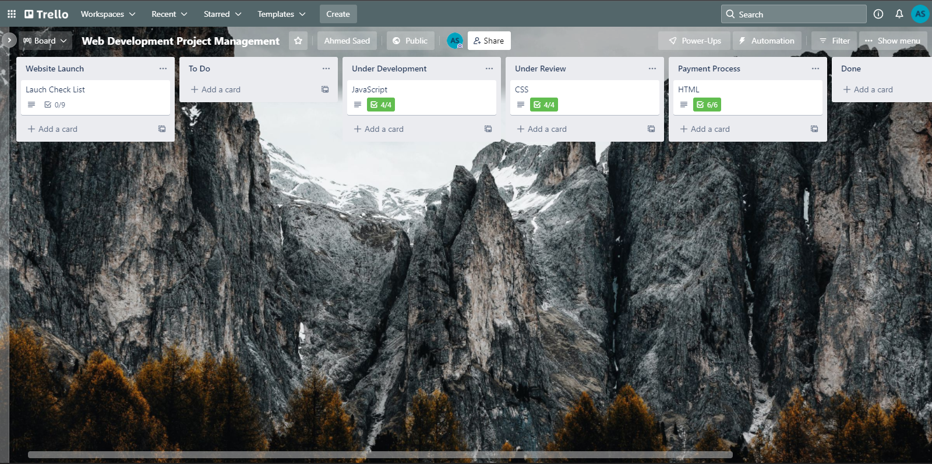
Trello Board
Please include the following information for your Trello board:
A link to your public Trello board should be provided here:
https://trello.com/b/84HWRl3o/web-development-project-management
Include a screenshot of the board below:
Paste screenshot here

Slide 8
Part 4
Invoice and Payment Options

Slide 9
Ahmed Saed
Cairo, Egypt
Invoice
Recipient:
Web development company
Cairo, Egypt
Invoice #: 159784
Date issued: 5/13/2022
Date due: 5/13/2023
Services Rendered
Service | Description of Work Done | Hours Spent | Amount Per Hour | Total
Creating website strucutre using HTML | Providing the main structure of the website and the content | 13 hours | 40$ | 520$
Styling and layout using CSS | - Styling the website content like elements and text - Make the website responsive for better user experience | 25 | 40$ | 1000$
Website Enhancements | Color scheme. General website theme Images & videos | 10 | 40$ | 400$
Security-related Enhancements | Better website security More stability Batches for common vulnerabilities | 10 | 40$ | 400$
Total Payment Due: 2320$

Slide 10
Payment Options
Below, write a sentence explaining what payment methods are accepted and how the client can pay for services rendered:
Answer:
Paypal: ahmedsaed2652003@gmail.com
Bank account:
103 street 1, New city, Cairo
Account Number: 000000001234

